Slide 1
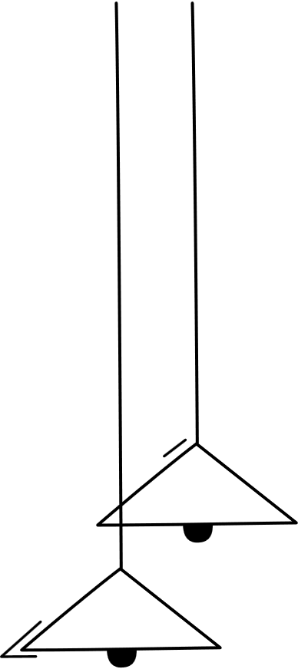
LAPTOP ANALYSIS IN PYTHON
Surya V
DA & DS

Slide 2
PROJECT OVERVIEW
The goal of this project is to analyze a comprehensive dataset of laptops, including detailed specifications such as brand, processor, Ram, storage, and graphics, to understand the key factors that influence laptop pricing and market positioning.
This analysis aims to serve two primary purposes
Consumers:
Help choose the best laptop based on needs and budget.
Show which laptops offer the most value for their price.
Manufacturers:
Understand what features matter most to buyers.
Set better prices and build laptops that match market demand.

Slide 3
DATA UNDERSTANDING
CATEGORICAL
Company
TypeName
ScreenResolution
Cpu & Gpu
Memory
OpSy
NUMERICAL
Inches
Ram
Weight
Price
Total rows:1303
Total column:12

Slide 4
DATA CLEANING
Check Outliers
Removed Unwanted column
Handling Missing Values
Drop Duplicates
Standardize Datatypes

Slide 5
Hypothesis Testing
1.T-tests were used to compare mean prices between two independent groups:
Weight vs Price: Weight significantly difference in price.
Price vs RAM: Price differs significantly based on RAM size
2.Chi-Square tests are used to assess whether there is a relationship between categorical variables.
Operating System vs TypeName: Variables are dependent. Indicating that the choice of OS depends on the laptop type.

Slide 6
UNIVARIANT ANALYSIS
Distribution of Laptop Prices
Number of Laptops by Company
Distribution of Inches
Distribution of RAM
Distribution of Memory
Distribution of Laptop Weight

Slide 7
BIVARIANT ANALYSIS
Price vs RAM
Screen Size vs Weight
Operating System vs Price
Price by Laptop Type
Laptop Price by Company
CPU Brand vs Price
GPU Brand vs Price

Slide 8
MULTIVARIENT ANALYSIS
Correlation Heatmap of Laptop Features
Pairplot of Laptop Features

Slide 9
INSIGHTS
Most laptops have 8GB RAM and 256–512GB SSD storage.
Most laptops are mid rang, with a few high-end ones over $300000
HP, Dell, and Lenovo have the most models.
Better specs = higher price (like more RAM, stronger GPU, faster CPU).
Razor,Apple laptops are the most expensive.
Gaming laptops cost more and are heavier.
15.6-inch screens are the most common.

Slide 10
RECOMMENDATIONS FOR CONSUMERS
Compare Specs vs. Price
Choose Based on Use-Case
Beware of Overpriced Models
Check Brand Reliability
Balance Performance and Portability

Slide 11
RECOMMENDATIONS FOR MANUFACTURES
Align Pricing with Specification
Target Specific Market Segments
Focus on Lightweight Designs
Enhance Differentiation
Monitor Competitor Trends

Slide 12
THANK YOU

